Slide 1
Introduction to neural nets
2/c cody BELLAMY
2/c justin steiner

Slide 2
What is a neural Net
Structure
Inputs
Hidden Layer(s)
Outputs
Learning
Cost function
Back propagation

Slide 3

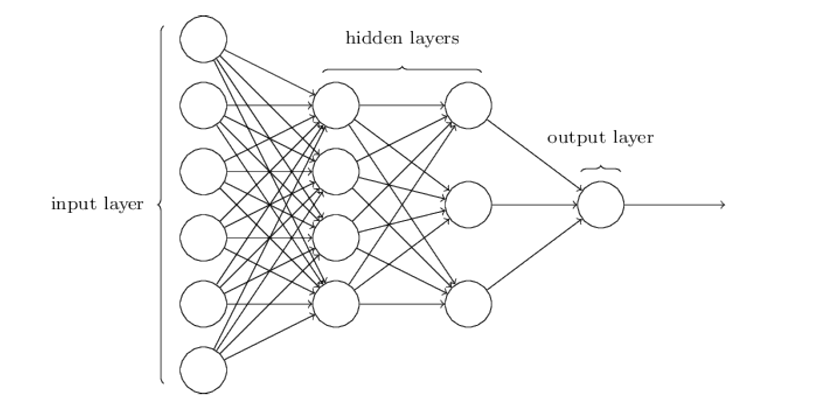
Structure
Oversimplified
Feed-forward
Variable Sizes
Input, hidden layers, output
Nodes
Perceptron
Sigmoid

Slide 4
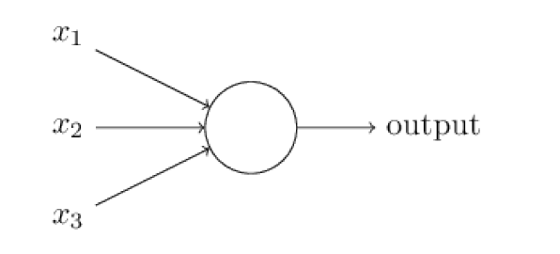
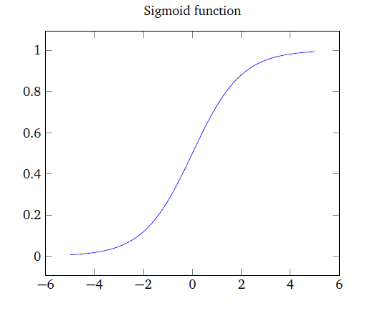
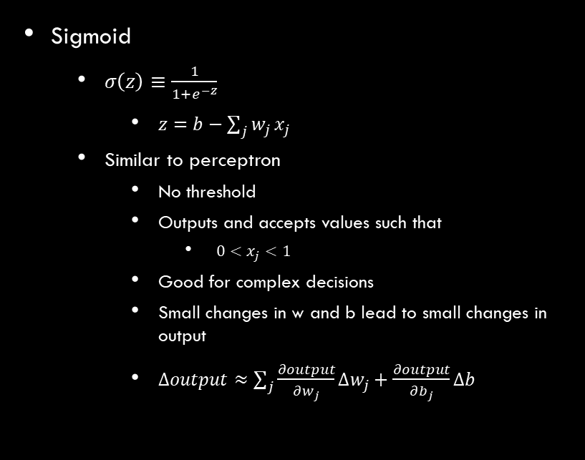
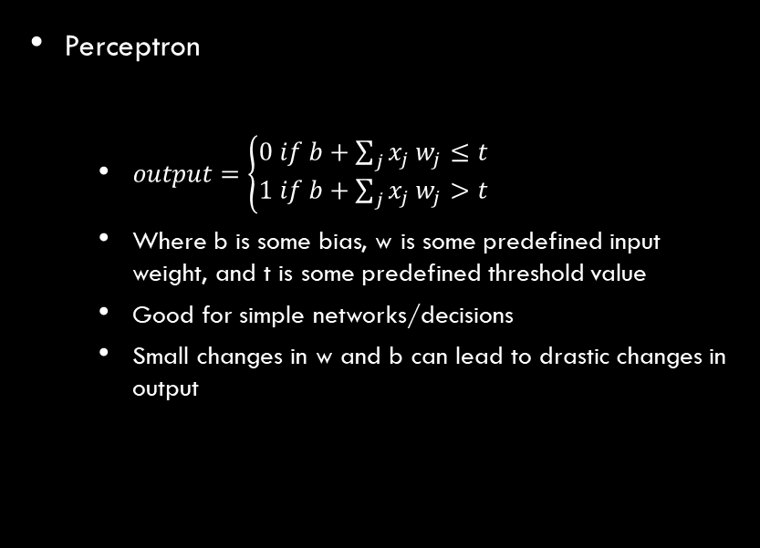
Perceptron vs sigmoid
Perceptron
$output=\left\{\begin{aligned}0 if b+\sum_{j}{x_{j}}w_{j}≤t \\ 1 if b+\sum_{j}{x_{j}}w_{j}>t\end{aligned}\right.$
Where b is some bias, w is some predefined input weight, and t is some predefined threshold value
Good for simple networks/decisions
Small changes in w and b can lead to drastic changes in output
Sigmoid
$σ\left(z\right)≡\frac{1}{1+e^{−z}}$
$z=b−\sum_{j}{w_{j}}x_{j}$
Similar to perceptron
No threshold
Outputs and accepts values such that
$0<x_{j}<1$
Good for complex decisions
Small changes in w and b lead to small changes in output
$∆output≈\sum_{j}{\frac{∂output}{∂w_{j}}∆w_{j}+\frac{∂output}{∂b_{j}}∆b}$

Slide 5
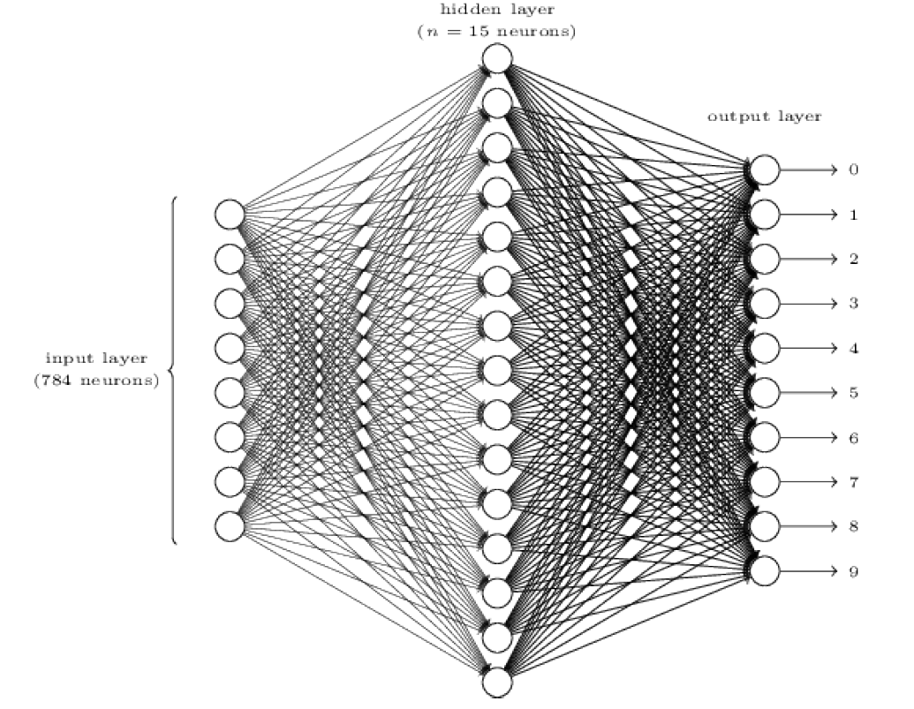
Practical Network
Recognizing handwritten digits
Justin’s rendition

Slide 6
Learning
Cost function
Function of weights and biases
Determines performance of network
Back propagation
Adjusts weights and biases towards “solution”
Steepest ascent problem

Slide 7
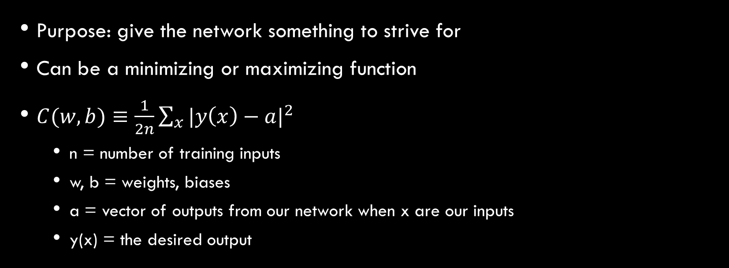
Cost function
Purpose: give the network something to strive for
Can be a minimizing or maximizing function
$C(w,b)≡\frac{1}{2n}\sum_{x}{{|y\left(x\right)−a|}^{2}}$
n = number of training inputs
w, b = weights, biases
a = vector of outputs from our network when x are our inputs
y(x) = the desired output

Slide 8
Cost function (cont.)
When C(w,b) is very high, our network is doing poorly
Vice versa when C(w,b)≈0
Known as quadratic cost or “mean square error” (MSE)
Why is this function useful?

Slide 9
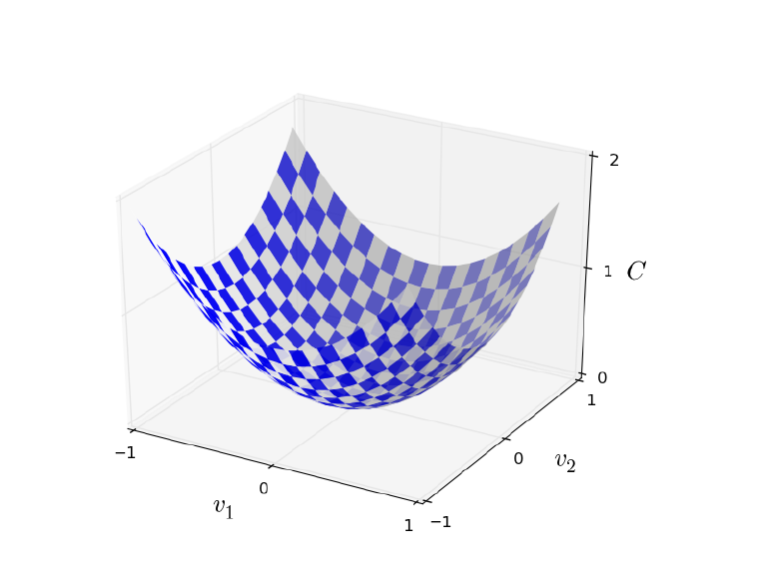
Minimizing cost
Since our function is “quadratic,” we can minimize mathematically using steepest ascent
Assuming two variables contribute to C(v)…

Slide 10
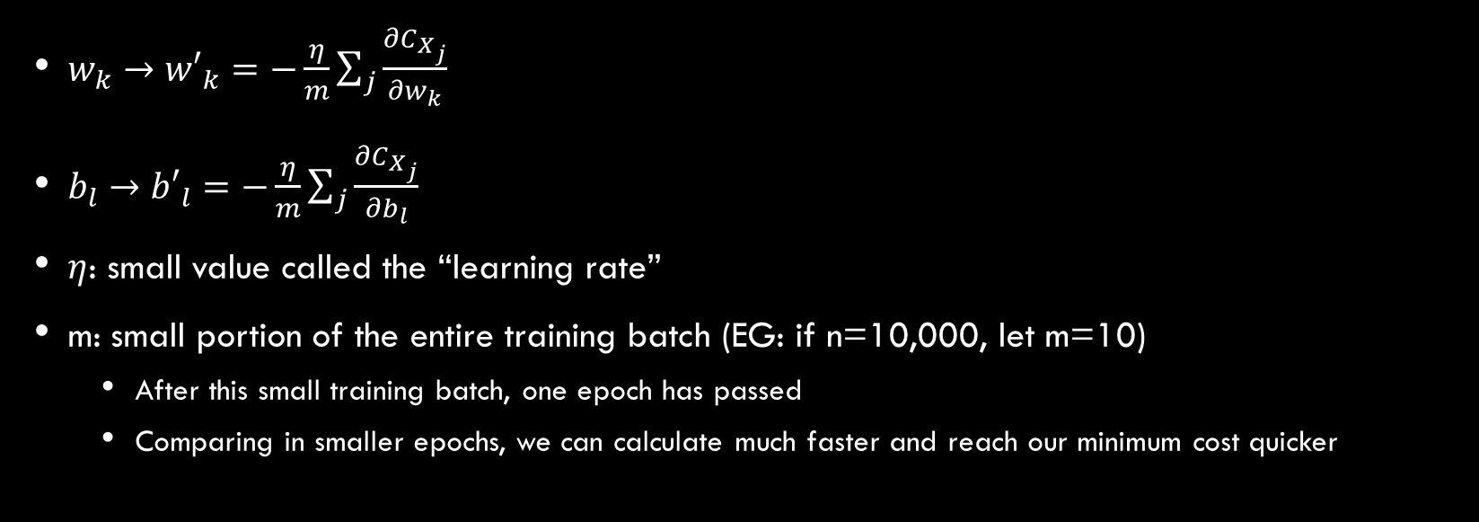
Intro to Back Propagation
$w_{k}→{w′}_{k}=−\frac{η}{m}\sum_{j}{\frac{∂C_{X_{j}}}{∂w_{k}}}$
$b_{l}→{b′}_{l}=−\frac{η}{m}\sum_{j}{\frac{∂C_{X_{j}}}{∂b_{l}}}$
$η$: small value called the “learning rate”
m: small portion of the entire training batch (EG: if n=10,000, let m=10)
After this small training batch, one epoch has passed
Comparing in smaller epochs, we can calculate much faster and reach our minimum cost quicker

Slide 11
Update w and b
Since backpropagation are a series of partial derivatives
Calculate the error (MSE)
Locally calculate “error”
Determine which direction to adjust our w and b
Adjust w and b at that node
Propagate error backwards through each layer
Repeat 2-6 until all nodes have been adjusted

Slide 12
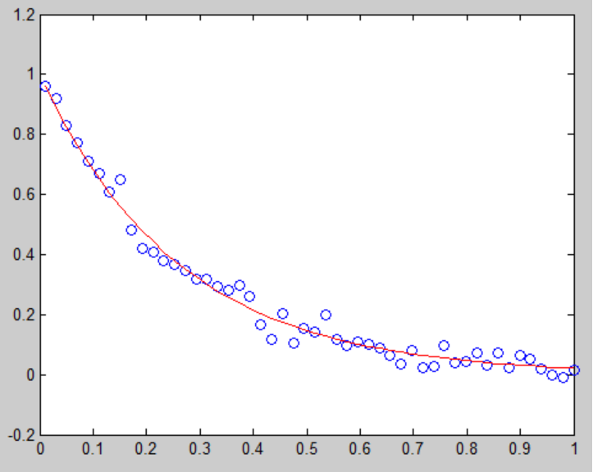
Curve fitting and overfitting
Predicting results
Do not want to overfit
Bad results
Do not want to underfit
Bad results
Can approximate results from new input data

